Slide 1
CT Perfusion Basics

Slide 2
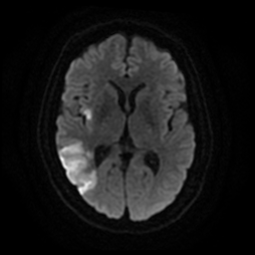
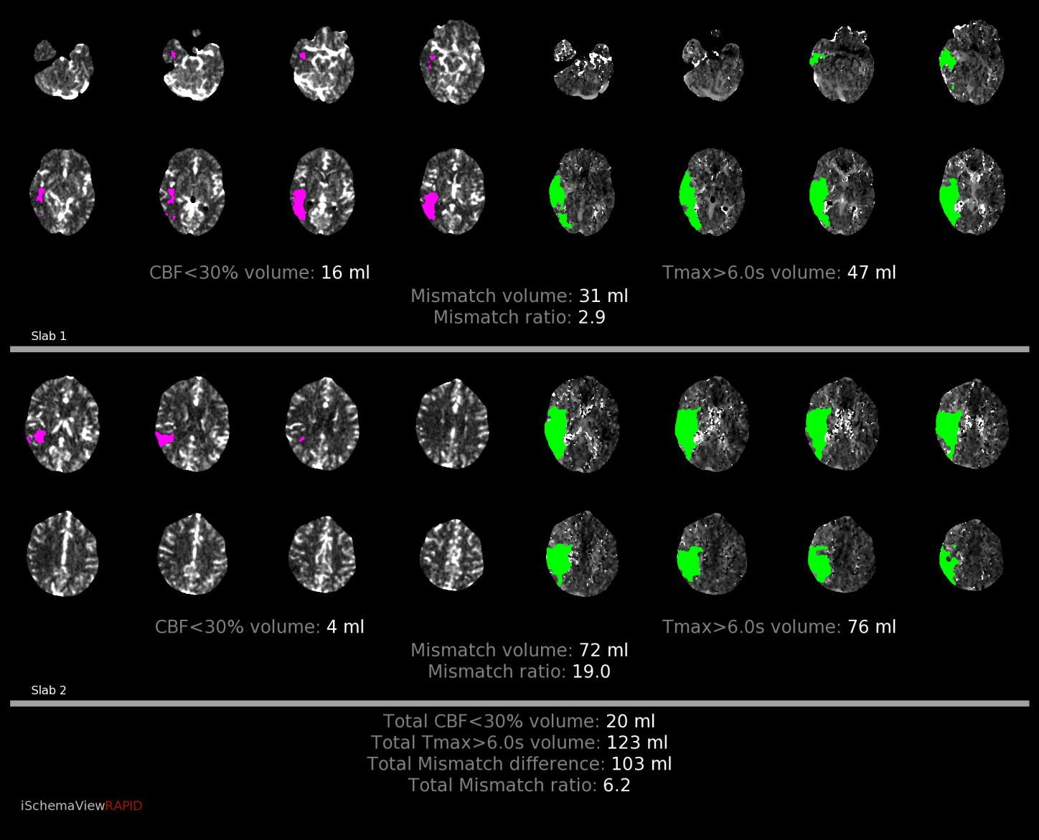
Basic terms to know in stroke
Core
  Infarcted brain, not salvageable
  Depicted by reduction of cerebral blood flow (CBF) less than 30% of normal (CBF <30% volume in mL)
  Essentially equivalent to area of diffusion restriction seen on MRI
Penumbra
  Hypoperfused brain at risk for progression to infarction, salvageable
  Usually located around the ischemic core, and represents target of reperfusion therapy
  Is represented by total area of hypoperfused brain MINUS infarcted core
  Depicted by prolonged time it takes for contrast to reach and traverse areas of the brain. Most commonly used threshold in CTP is Tmax > 6s.

Slide 3
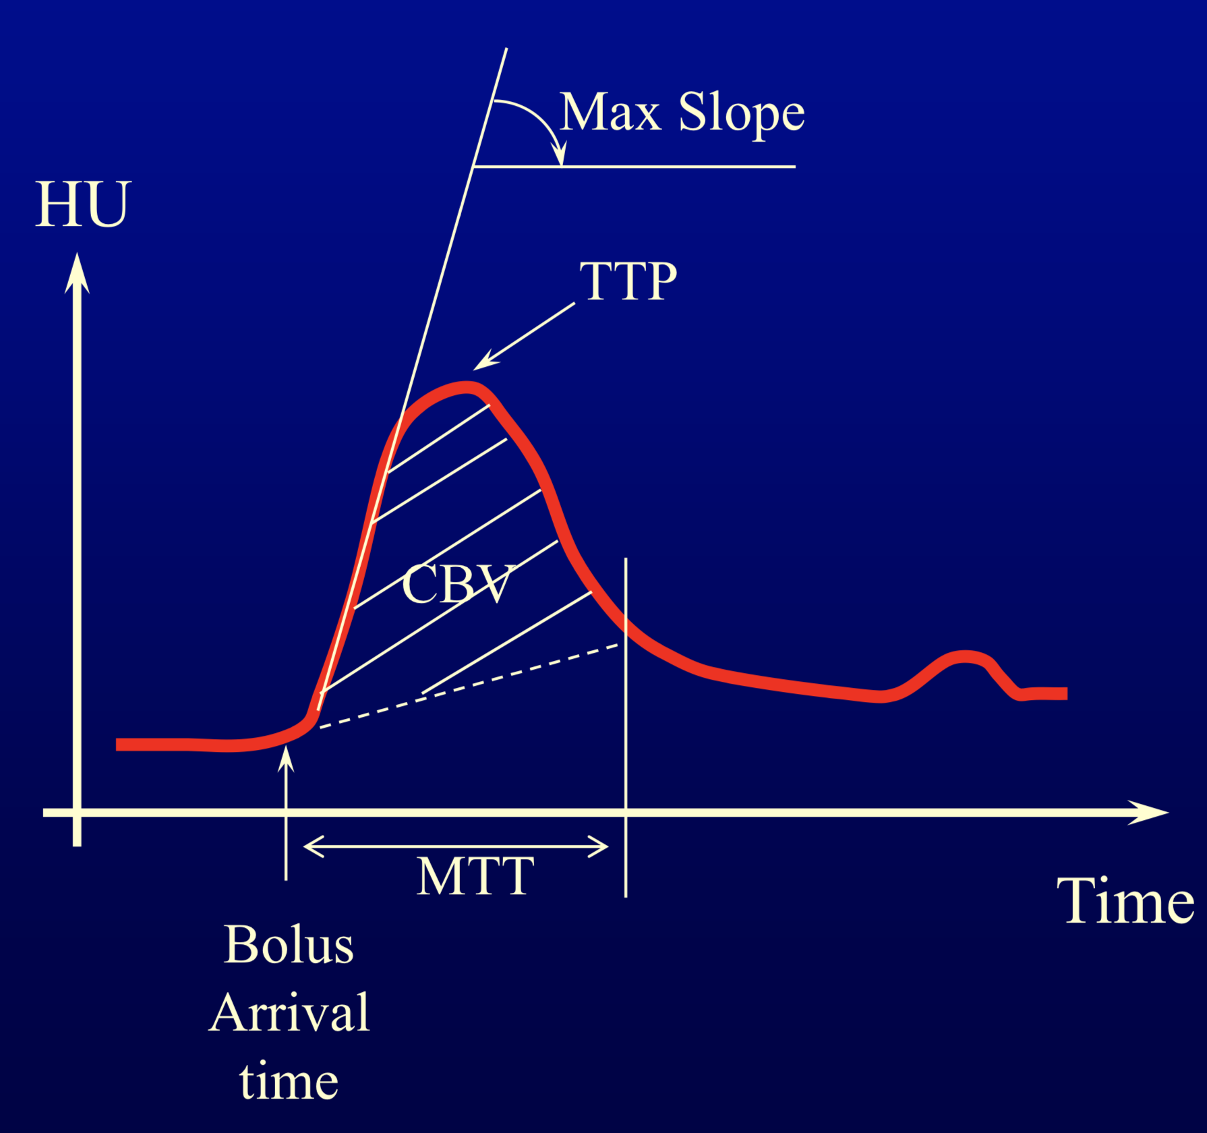
Basic terms to know in stroke
Time to Peak (TTP)
  Length of time in seconds to reach peak voxel enhancement
  Indicator of delayed flow in the setting of stenosis or occlusion
  Increased when abnormal
Mean Transit Time (MTT)
  Length of time in seconds for blood to move from arteries -> capillaries -> veins
  Increase indicates vasodilatory response to reduced flow
  MTT = CBV/CBF
Time to maximum (Tmax)
  Time at which maximum value of residue function occurs after deconvolution
  Represents delayed arrival of contrast bolus
Tmax and CBF are the main parameters used to determine core and penumbra

Slide 4
Basic terms to know in stroke
Cerebral blood volume (CBV)
  Volume flow rate through cerebral vasculature per unit time (ml/100g of brain tissue)
  Penumbra may demonstrate normal or increased CBV with autoregulation
Cerebral blood flow (CBF)
  Amount of blood flowing through capillaries per unit time per unit tissue (ml/min/100g brain tissue)
  Identifies areas of low blood flow (hypoperfusion)
  Infarct core displays decreased CBF by <30%
Mismatch Volume and Mismatch Ratio
  Mismatch volume = Difference in volume between total hypoperfused area and core infarct, equals penumbra
  Mismatch ratio = Ratio of total hypoperfused area and core infarct
Tmax and CBF are the main parameters used to determine core and penumbra

Slide 5
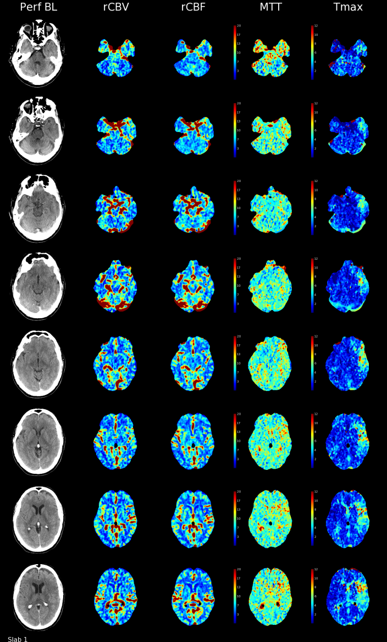

What it looks like (RAPID software, update with Viz AI when have examples)
Color maps corresponding to the 2 slabs obtained (below)
Need to use the TOTAL values provided which sums the two slabs for better coverage
Color maps also provided (right, different example), can help with assessing global picture

Slide 6
Questions to answer by CT
Hemorrhagic versus ischemic stroke?
  Noncontrast head CT
Evidence of large vessel occlusion?
  CT angiography
What tissue is infarcted (core) and what is salvageable (penumbra)?
  CT perfusion

Slide 7
Performance of CT Perfusion
Monitor first pass of contrast bolus through cerebral circulation
  Usually performed at 2 separate slabs to maximize coverage with first slab parallel to and just above the orbital roof, and the second more superiorly to avoid any overlap in slabs
  Power injection at between 4-7 mL/sec
CT angiography is then performed with additional bolus of contrast
CT perfusion software analyzes data and generates color maps and outputs values
  Usually a threshold HU below which the software does not include as an area of hypoperfusion to avoid counting prior infarcts/encephalomalacia in calculations

Slide 8
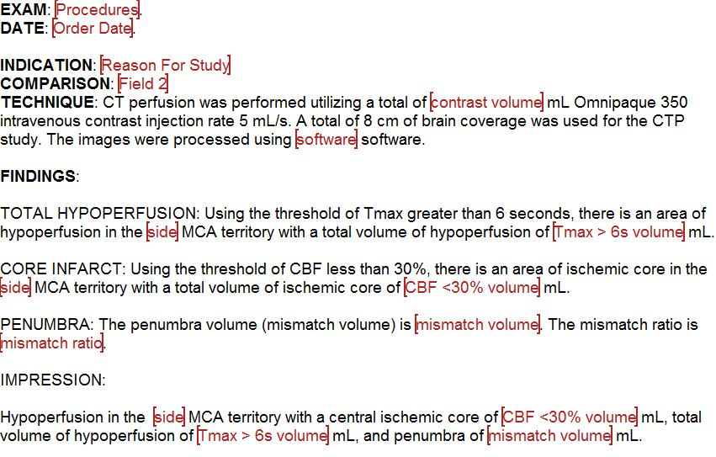
Sample dictation template

Slide 9
Target values for reperfusion
May be in constant evolution and not strictly defined
  Ischemic core volume < 60-70 mL
    May vary depending on location of infarct and patient age with desired aggressiveness
  Mismatch ratio > 1.8
  Mismatch volume ≥ 15 mL

Slide 10
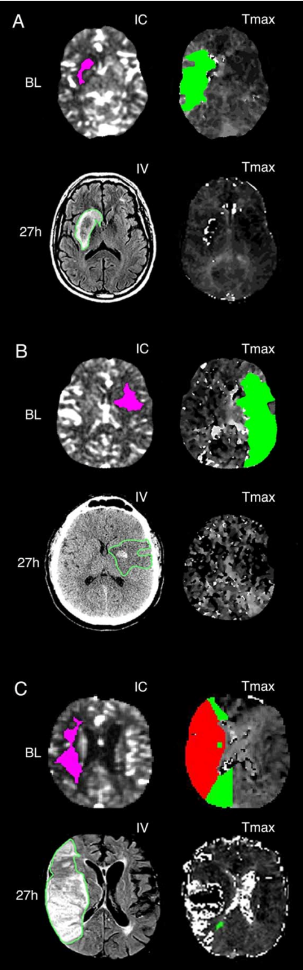
Pitfalls
Underprediction of final infarction by core
Examples where 27-hour infarct volume is larger than predicted infarct volume.
The baseline core is 14ml (pink); following complete reperfusion, the 27-hour infarct volume is 45ml (green outline) and demonstrates hemorrhagic transformation.
The baseline core is 10ml (pink); following complete reperfusion, the 27-hour infarct volume (green outline) is 47ml and has hemorrhagic transformation.
Example of the malignant profile. The baseline core is 24ml (pink) and the Tmax>10-second volume (shown in red) is 177ml. Following 98% reperfusion, the 27- hour infarct volume (green outline) is 269ml. IC ischemic core; IV infarct volume
Albers, Gregory W., et al. "Ischemic core and hypoperfusion volumes predict infarct size in SWIFT PRIME." Annals of neurology 79.1 (2016): 76-89.

Slide 11
Pitfalls
Core infarct may not show up if there is later recruitment of collateral vessels from ACA and PCA (“futile leptomeningeal perfusion”)
If imaging patients very early (within an hour) after stroke, the volume of core infarct may be substantially overcalled at a CBF <30% threshold. Within an hour of stroke, a CBF <20% threshold may be more appropriate (not used in current practice)
Understand that areas of brain with HU under a certain threshold (approaching CSF density) will not be counted as core infarct, assumed to represent encephalomalacia
Software may only include lesions greater than 3 mL on mismatch maps so lacunar infarcts may not show up. They may be visible on the global color maps if provided.

Slide 12
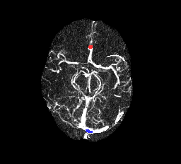
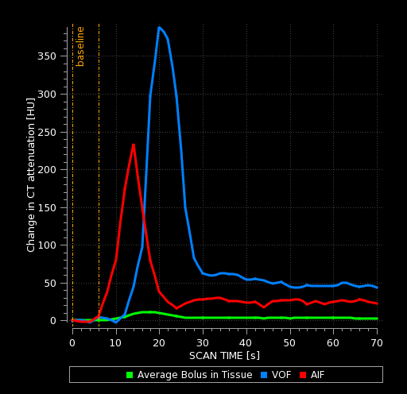
Pitfalls
AIF (arterial input function) and VOF (venous output function)
  AIF often placed on A2 segment of anterior cerebral artery due to its course and easy visualization on multiple axial images. The MCA is often used as well.
  VOF often placed on superior sagittal sinus
  Inappropriate placement of either can give appearance of global perfusion abnormality or other abnormality
  If images or numbers don’t look right, verify placement of AIF and VOF and look at time curves
    Make sure there is good bolus and curves have sharp upstroke
    If there are a lot of jagged lines in the curves, it is suggestive of movement
  Make sure that there is no truncation of the curves (stopped scanning too early)
Good AIF and VOF placement and curves

Slide 13
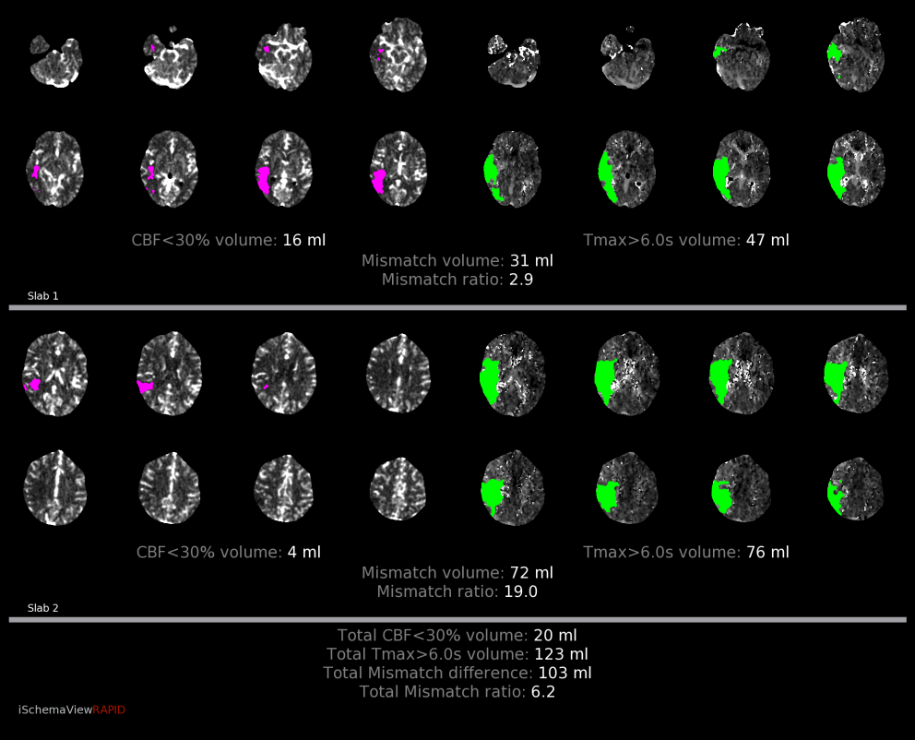
Case 1
CT perfusion shows area of hypoperfusion in right MCA territory with total volume of 123 ml, core of 20 mL, and penumbra of 103 mL
Patient underwent successful RICA angioplasty and R MCA thrombectomy
Followup DWI MRI closely matches initial area of core infarct seen on CT perfusion, with sparing of some of penumbra area

Slide 14
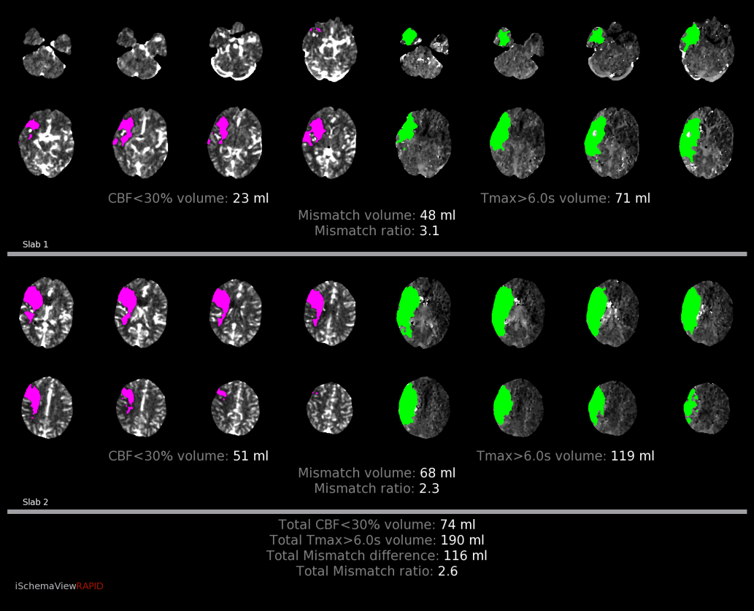
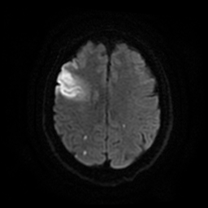
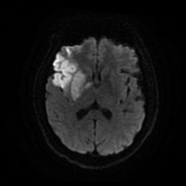
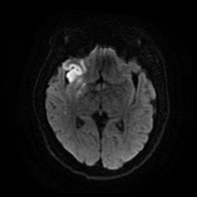
Case 2
CT perfusion shows area of hypoperfusion in right MCA territory with total volume of 190 mL, core volume of 74 mL, and penumbra of 116 mL
Patient underwent successful RICA and R MCA thrombectomy
Followup DWI MRI closely matches initial area of core infarct seen on CT perfusion, with sparing of much of penumbra area

Slide 15
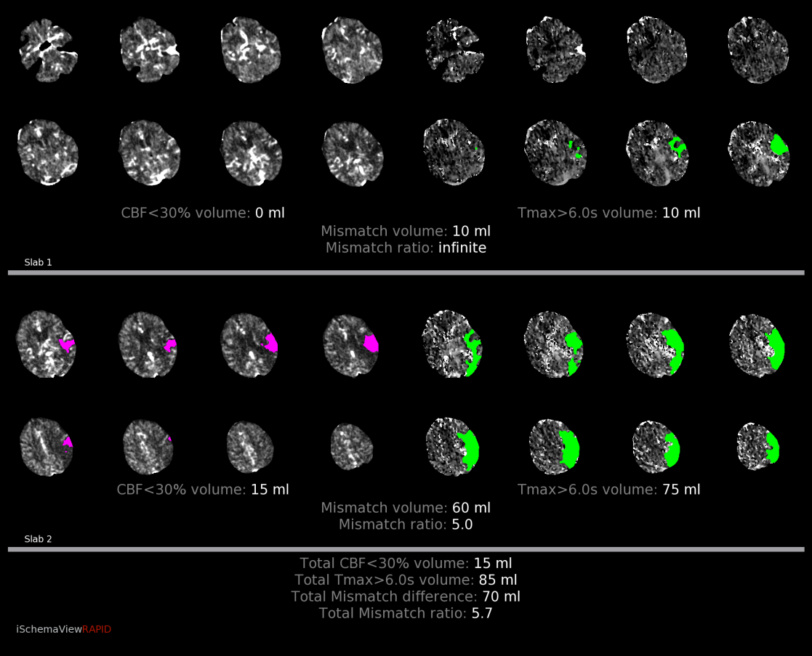
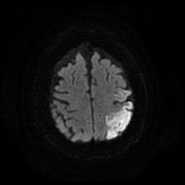
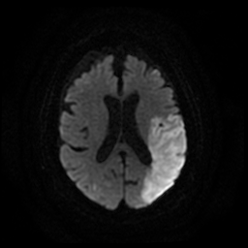
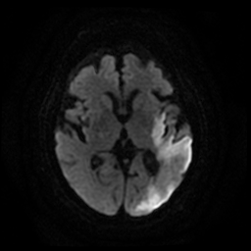
Case 3
CT perfusion shows area of hypoperfusion in left MCA territory with total volume of 85 mL, core infarct of 15 mL, and penumbra of 70 mL
Attempted left MCA thrombectomy was unsuccessful
Followup DWI MRI shows infarct closely resembles initial CT perfusion area of penumbra which has progressed to infarct

Slide 16
Summary
Total hypoperfused brain volume
  Volume of brain with Tmax > 6 sec
  Equivalent to infarct core PLUS surrounding penumbra
Infarct core volume
  Volume of brain demonstrating CBF < 30%
  Non-viable/non-salveagable brain
Penumbra volume
  Total hypoperfusion volume MINUS core volume
  Equals mismatch volume
  Potentially salveagable brain

